Slide 1

The virtual road toward a new normal: thinking and interacting
Professor Nan Bahr
Deputy Vice Chancellor (Students)
Southern Cross University
Australia

Slide 2





Today I went to work!!

Slide 3








Who are we online?

Slide 4




Can you be sure who you are communicating with?
Networked identity
Are you safe?
Have you given too much of yourself and your personal information away?

Slide 5
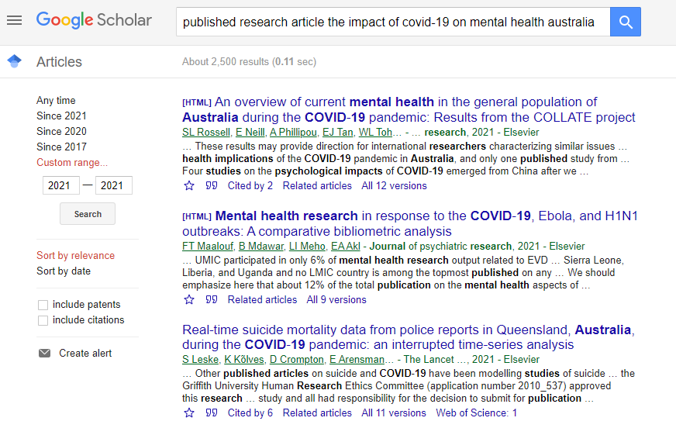

The COVID-19 effect on mental health

Slide 6



Technology and work intensification

Slide 7


The financial burden of mental health
$11bn per year in response to the costs of absenteeism, reduced work performance, increased turnover rates and compensation claims

Slide 8

Privacy
95% of data breaches are from human error
Data protection is about to reach a cost of $140bn for 2021
Approximately 300bn passwords are used worldwide

Slide 9
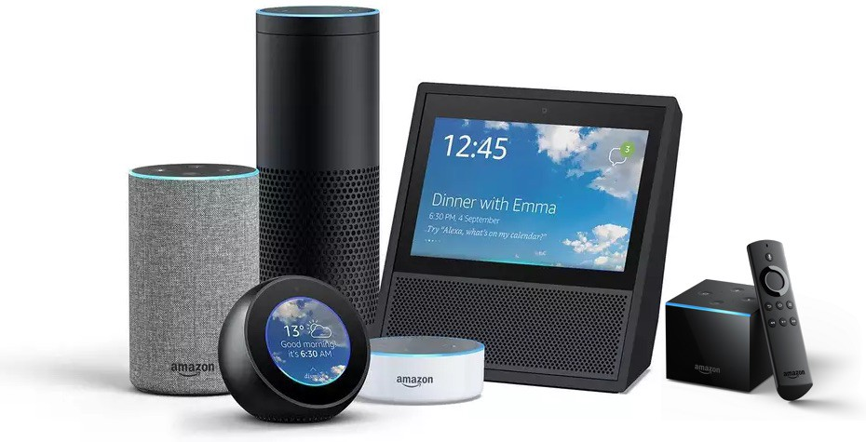

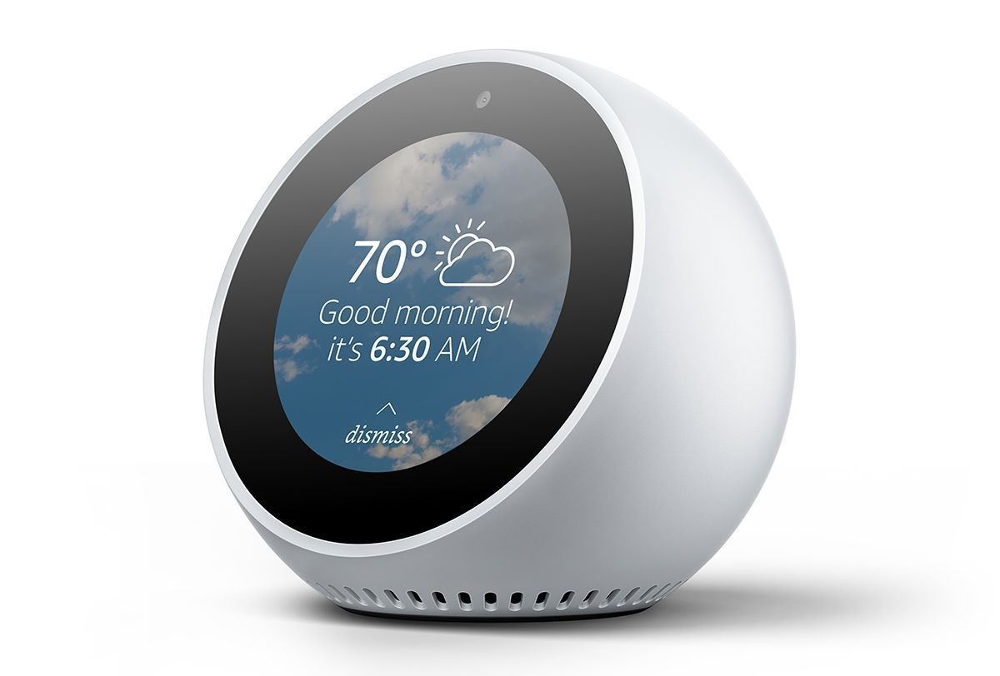
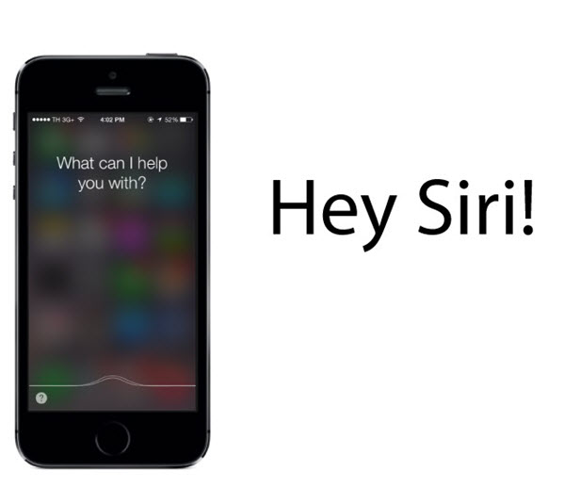

Conclusion
This is the new normal!

Slide 10

Questions

